Slide 1
Learning Transferable Visual Models From Natural Language Supervision
Group 6
Chinmay Shah
Joshua J. Cook
Moise Brutus
Praya Cheekapara

Slide 2
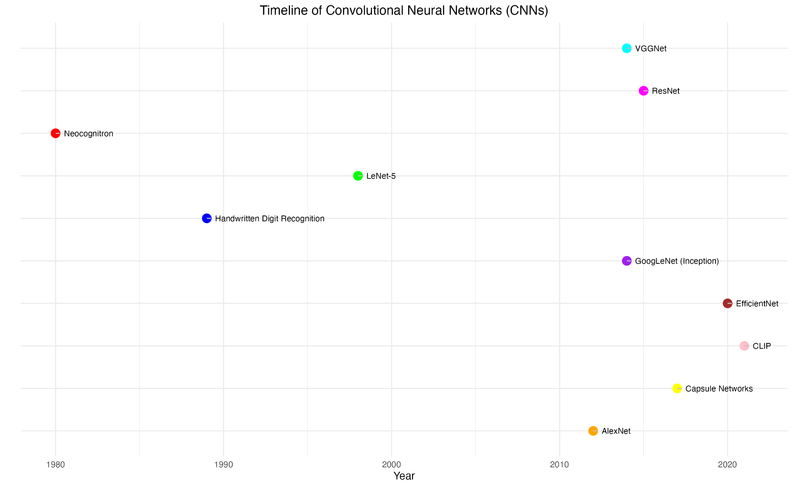
Related Work (1970s-Present)
Figure 1. Timeline of CNN development. CNN development was initiated by the work of Fukushima in the 1970s and 1980s via the introduction of the Cognitron and Neocognitron. This spurred the development of more complex CNNs during the 1990s such as LeNet-5, and modern models such as GoogLeNet and CLIP [1-6].

Slide 3
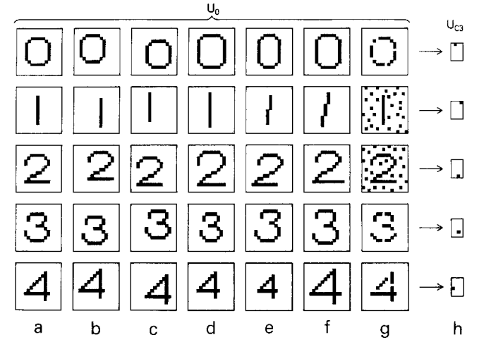
1970s and 1980s
Fukushima Et. Al. - The Cognitron and Neocognitron (1980)
Network of simple and complex “cells”
Capable of recognizing geometric similarities
Cognitron -> Neocognitron = network not affected by the position of individual stimulus patterns (i.e., shifted patterns or shift invariance)
Also capable of supervised learning
Fukushima, K. Neocognitron: A self-organizing neural network model for a mechanism of pattern recognition unaffected by shift in position. Biol. Cybernetics 36, 193–202 (1980). https://doi.org/10.1007/BF00344251

Slide 4
1990s
Lecun, Yann & Bottou, Leon & Bengio, Y. & Haffner, Patrick. (1998). Gradient-Based Learning Applied to Document Recognition. Proceedings of the IEEE. 86. 2278 - 2324. 10.1109/5.726791.
LeCun Et. Al. - Backpropagation and LeNet-5 (1998)
Gradient descent method (stochastic), used to train neural networks
Applied to MNIST image database (60,000 training, 10,000 testing)
Introduction of Architecture: Convolutional, Pooling, FC, and Gaussian Layers
Limited by small datasets

Slide 5
2000s
J. Deng, K. Li, M. Do, H. Su, L. Fei-Fei, Construction and Analysis of a Large Scale Image Ontology. In Vision Sciences Society (VSS), 2009.
Fei Fei Li - ImageNet (2006)
First large-scale database for images (now 14m+); not just numbers!
Based on WordNet (english text)
Crowdsourcing with Amazon; images are not copyright
ImageNet Large Scale Visual Recognition Challenge (ILSVRC)

Slide 6
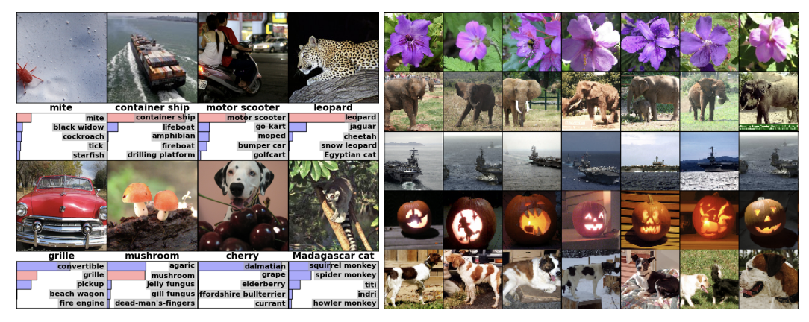
2010s - after ImageNet
Krizhevsky, Alex & Sutskever, Ilya & Hinton, Geoffrey. (2012). ImageNet Classification with Deep Convolutional Neural Networks. Neural Information Processing Systems. 25. 10.1145/3065386.
Krizhevsky Et. Al. - AlexNet (2012)
Won the 2012 ILSVRC with a CNN / ImageNet dataset
Error of 15.3%; 10.8% less than runner-up
Architecture: 8 layers (5 convolutional, 3 FC); ReLU activation functions, dropout for regularization, GPU acceleration
1.2m images, 650,000 neurons, 60m parameters
Simonyan Et. Al. - VGGNet (2014) - small convolutional filters
Google - GoogleLeNet (2014) - inception module
Microsoft - ResNet (2015) - residual learning
Hinton Et. Al. - Capsule Networks (2017)
Google - EfficientNet (2019) - scaling CNNs

Slide 7
2020s - CLIP
Radford Et. Al. / OpenAI - Contrastive Language-image Pre-training (CLIP) (2021)
CNN that learns visual concepts from natural language supervision
Trained on a combination of images and their captions
Bridges the gap between traditional CNN and natural language processing
Generalization across tasks
Increased flexibility and scalability
Interface to natural language

Slide 8
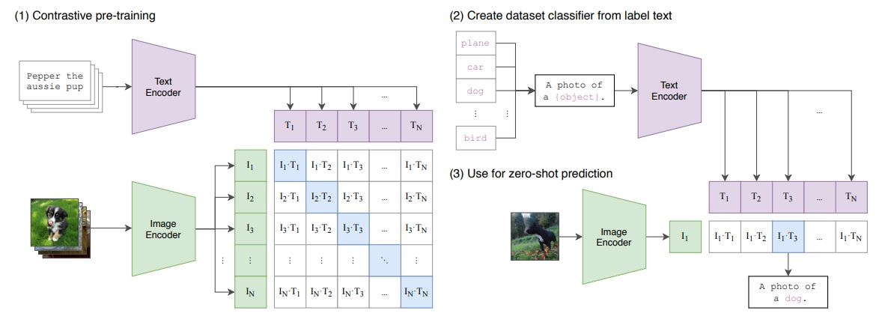
Methodology
1. Multimodal Understanding: CLIP understands both text and images, associating descriptions with visual representations.
2. Pretraining: Trained on a large dataset, CLIP aligns text and images in a shared semantic space.
3. Vision Transformer Backbone: Uses a Vision Transformer architecture to process images and capture spatial relationships.
4. Text Embedding: Converts words into dense vectors to capture semantic content and context.
5. Cross-Modal Alignment: Aligns image and text embeddings for tasks like image classification and visual question answering.
6. Zero-Shot Learning: Generalizes to recognize novel concepts with minimal task-specific training data.

Slide 9
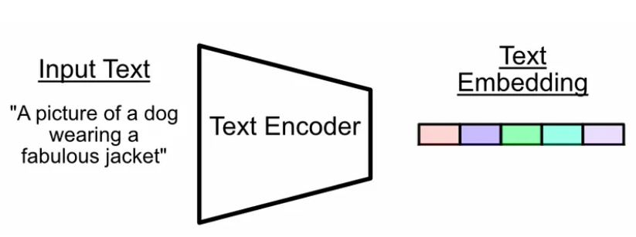
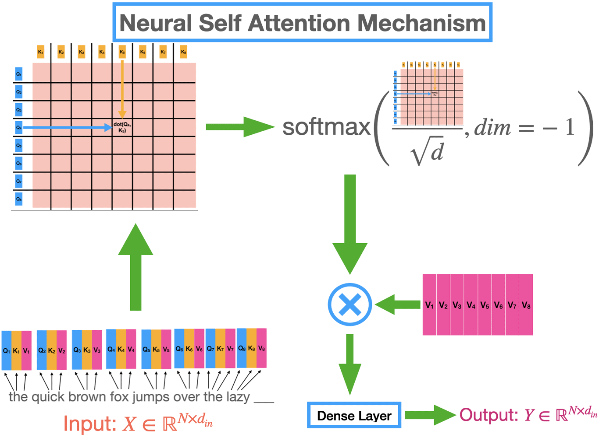
Text Encoder
A transformer can be thought of as a system which takes an entire input sequence of words, then re-presents, and compares those words to create an abstract and contextualized representation of the entire input.
Transformer
Transformers are primarily used in natural language processing (NLP) tasks, such as language translation, text generation, and sentiment analysis, but has also been applied to other domains.
The key innovation of the Transformer architecture is the self-attention mechanism, which allows the model to weigh the importance of different words in a sentence when processing each word.
Transformers consist of an encoder-decoder architecture, where the encoder processes the input sequence and the decoder generates the output sequence. Each encoder and decoder layer in a Transformer contains multi-head self-attention mechanisms and a fully connected feed-forward networks.

Slide 10
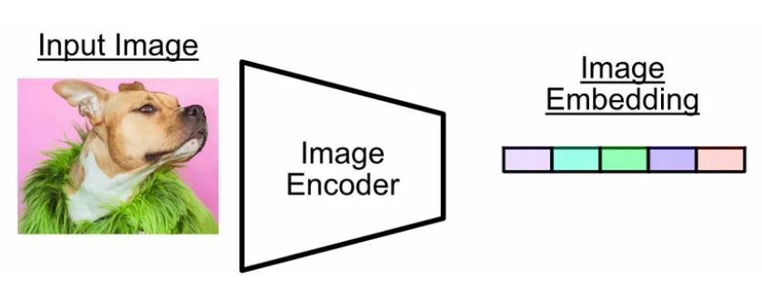
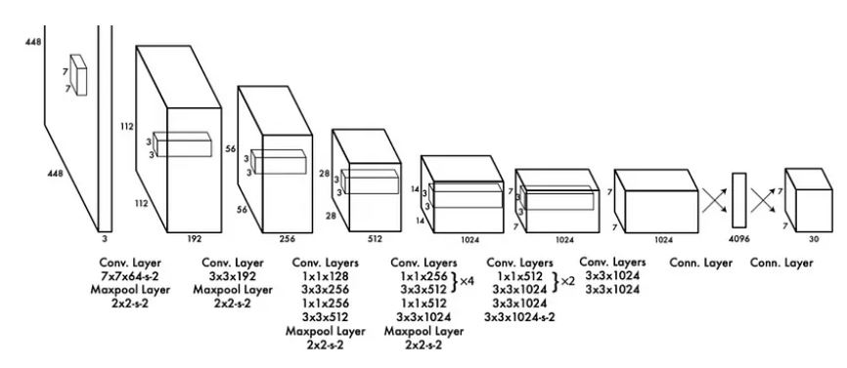
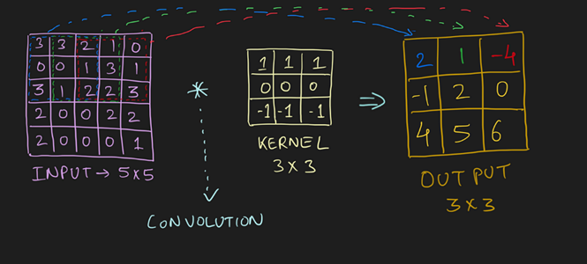
Image Encoder
The image encoder converts an image into a vector (a list of numbers) that represents the image’s meaning.
Convolution Neural Network
A Convolutional Neural Network (CNN) is a type of deep learning model designed specifically for processing structured grid-like data, such as images. It consists of multiple layers of convolutional, pooling, and fully connected layers, enabling it to learn hierarchical representations of visual features from input images. CNNs leverage convolutional filters to extract local patterns and features from the input data, while pooling layers help reduce spatial dimensions and control overfitting.
Convolution
Convolution is a mathematical operation that applies a filter or kernel to an input signal, extracting features by sliding the filter across the input and computing element-wise multiplications and summations.

Slide 11
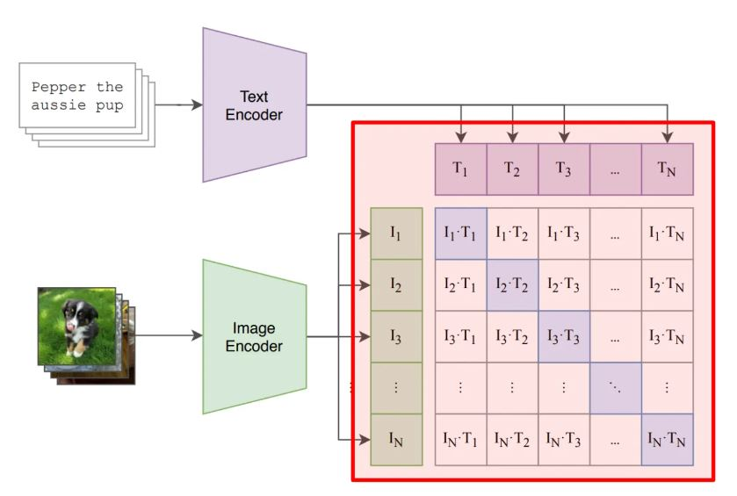
Working of the Clip Model
Putting everything together
Comparing the output of the text encoder and the image encoder and calculating the similarity matrix.
The prompt inputs and the text inputs are arranged in the same order.
All the elements on the diagonal should have the highest value.
Cosine similarity is a measure used to determine the similarity between two vectors in a high-dimensional space by computing the cosine of the angle between them. Cosine similarity is valuable for comparing the similarity of documents, sentences, or words represented as vectors in a vector space model.

Slide 12
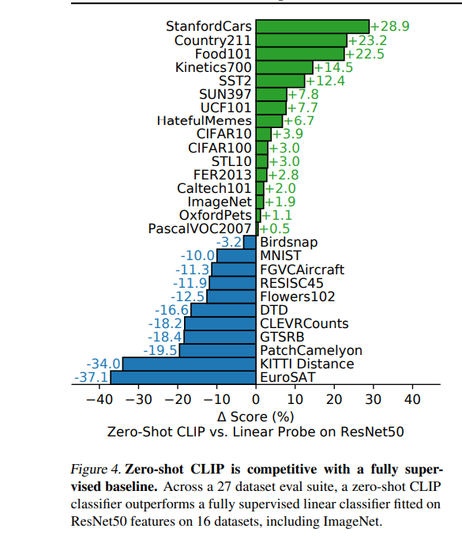
Impact and Critical Assessment
-Since CLIP allows people to design their own classifiers, how classes are designed influences model performance and model biases.
-There are also discrepancies across gender and race for the people categorized into “crime” and “non-human” categories even when care is taken into thoughtful class design.
- CLIP does not need task-specific training data, it can unlock specific tasks with greater ease.This also means that it may raise privacy or surveillance related risks

Slide 13
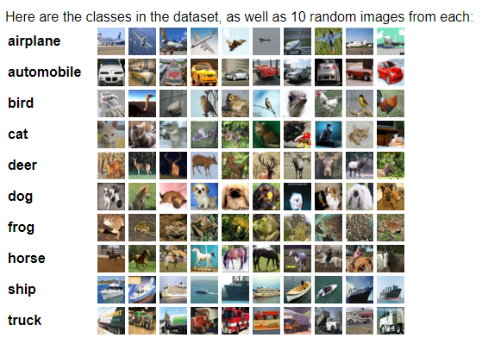
Replication of Work - Dataset Used
CIFAR Data Set
50,000 Images Training
10 Classes, 5,000 Images Per Class
10,000 Images Testing
10 Classes, 1,000 Images Per Class

Slide 14
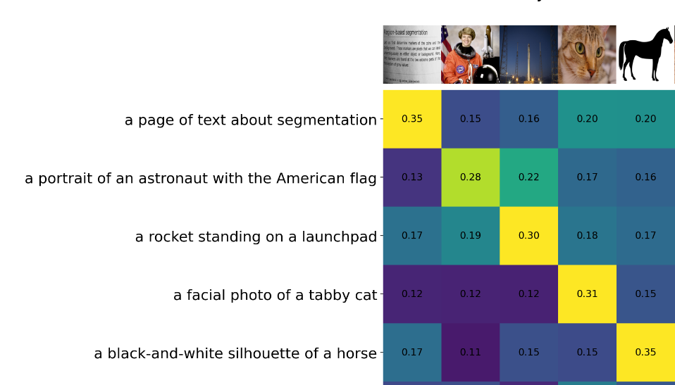
Replication of Work - Similarity Matrix Example

Slide 15
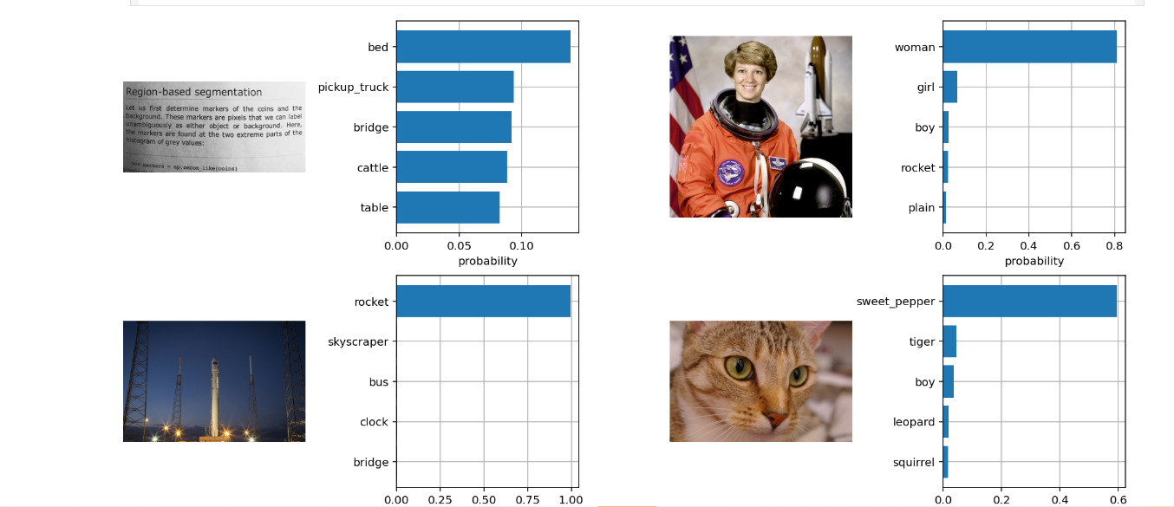
Replication of Work - Zero Shot Example
-Zero shot classification models are pre trained models that can classify images without being trained or having knowledge of classes.
-It allows you to classify images using the cosine similarity as the logits to the softmax operation.

Slide 16
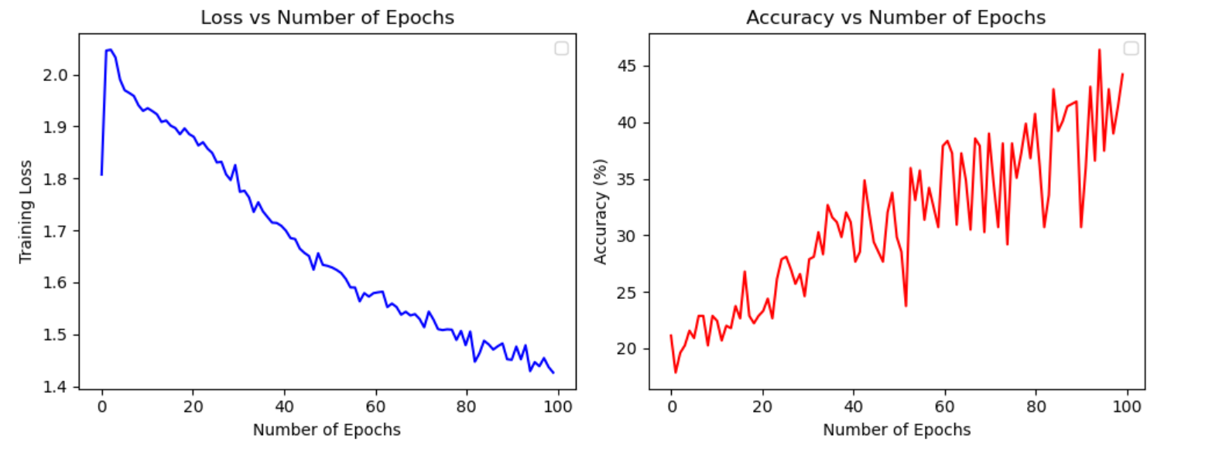
Replication of Work - Model Training
Trained the model to specified data set for 100 epochs using a cross entropy loss.
The training script compared the highest of every row and the loss was calculated by comparing if the index of the highest value was consistent with the number of the image and text pair being compared.
As the number of epochs increased we observed the loss of the model go down and and accuracy of the model increase on the small validation dataset.
The loss didn’t quite go to zero, due to hardware limitation we were only able to train on a small subset of the data.

Slide 17
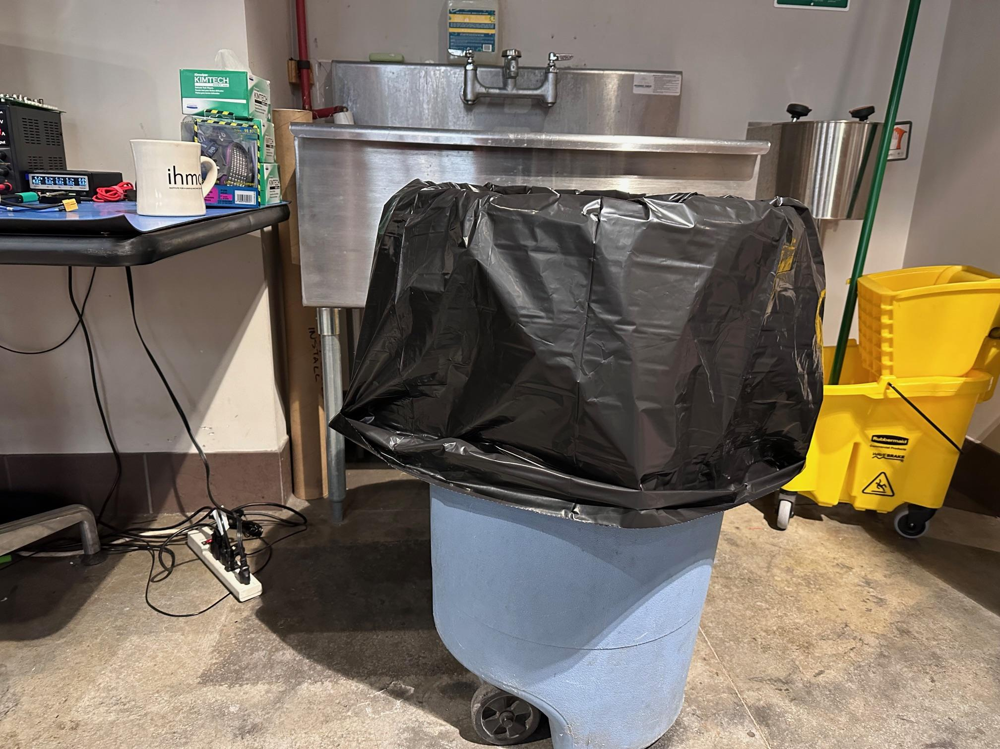
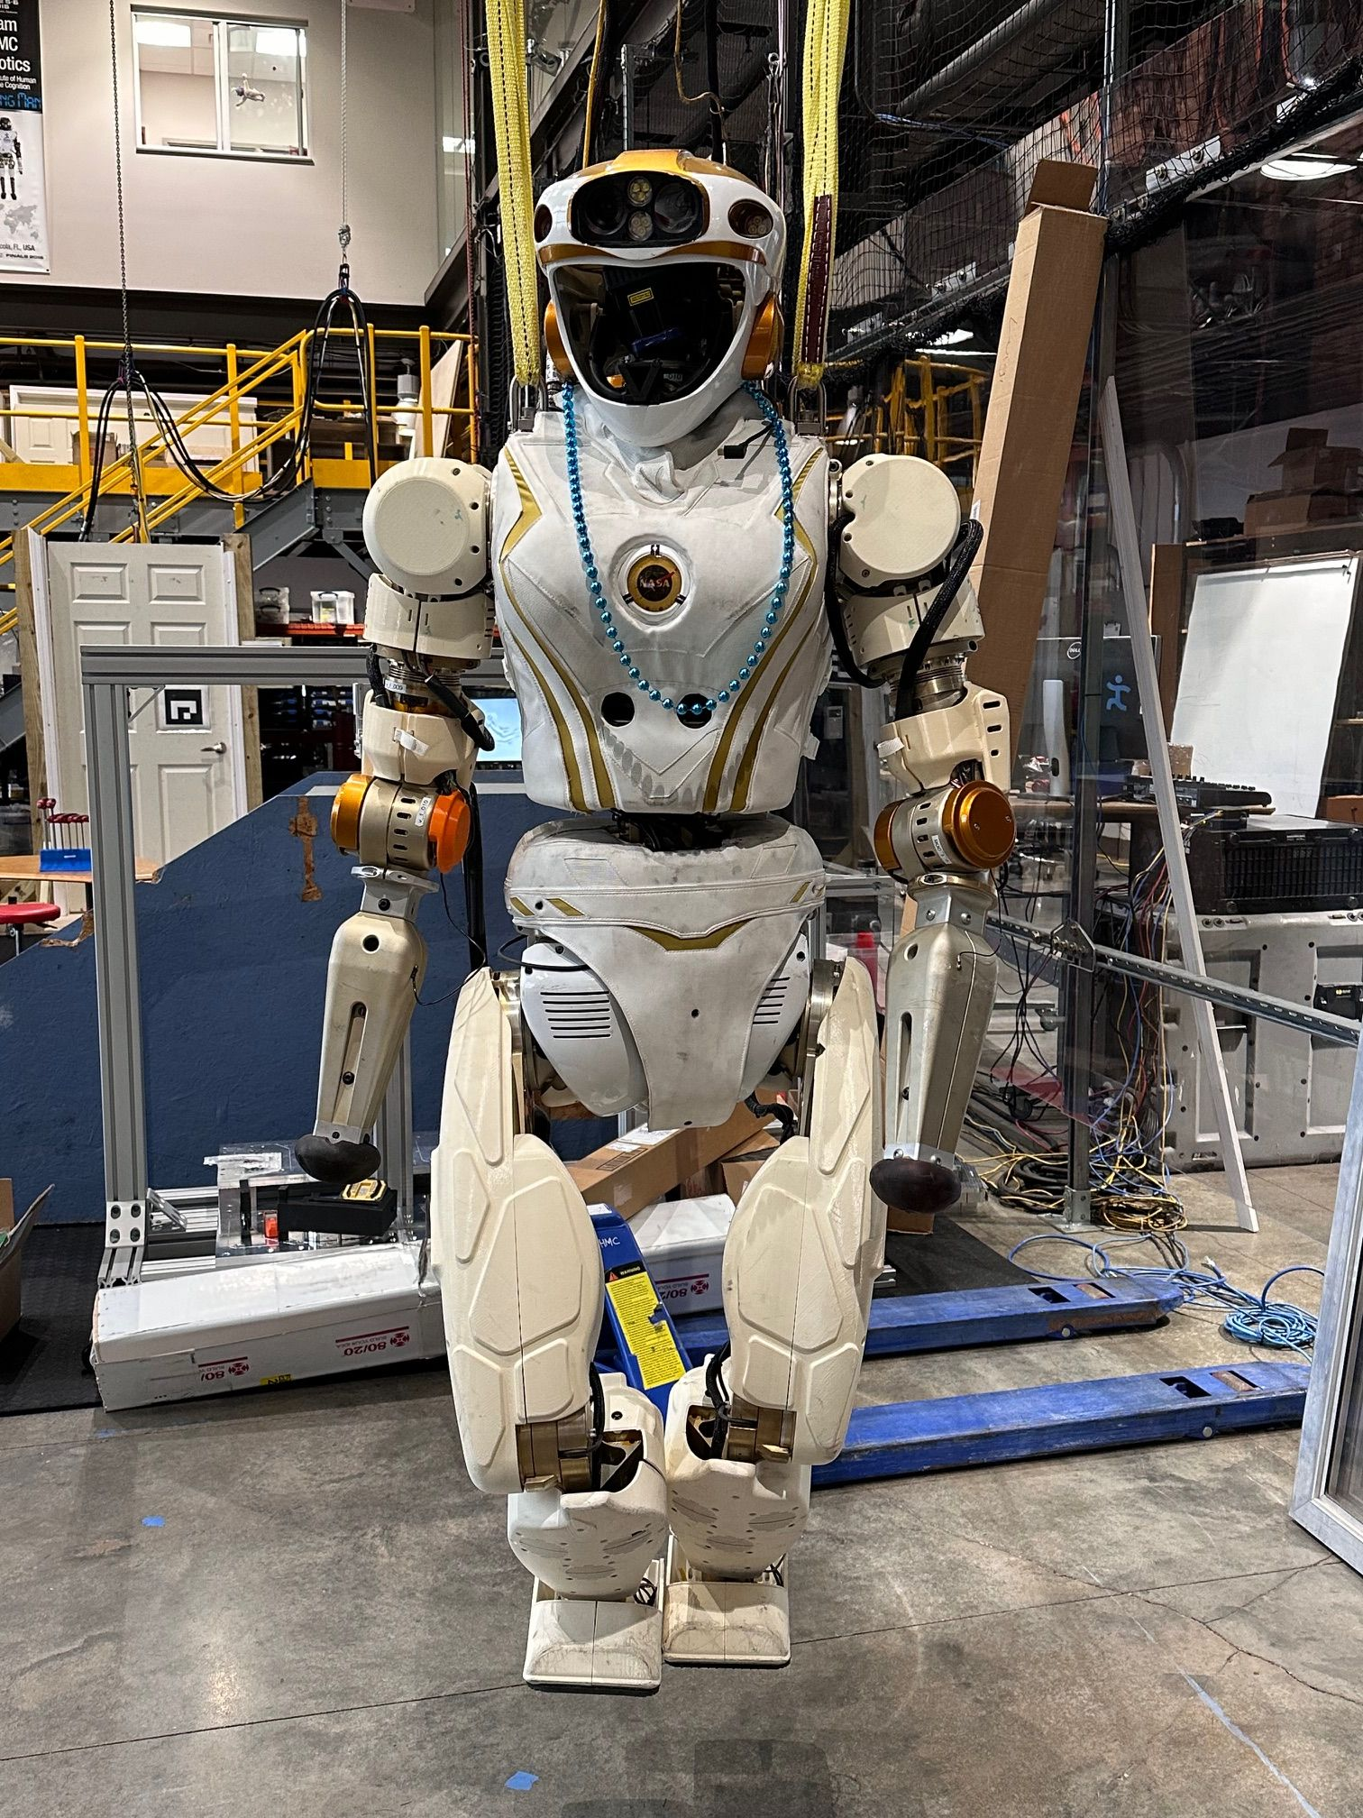
Application
Humanoid Robot application
Generates prompts to relay the actions the robot can perform.
Allow the user to select the appropriate action they want the robot to perform.
“Pick up the mug ? ”
“Dispose of the trashcan ? ”

Slide 18
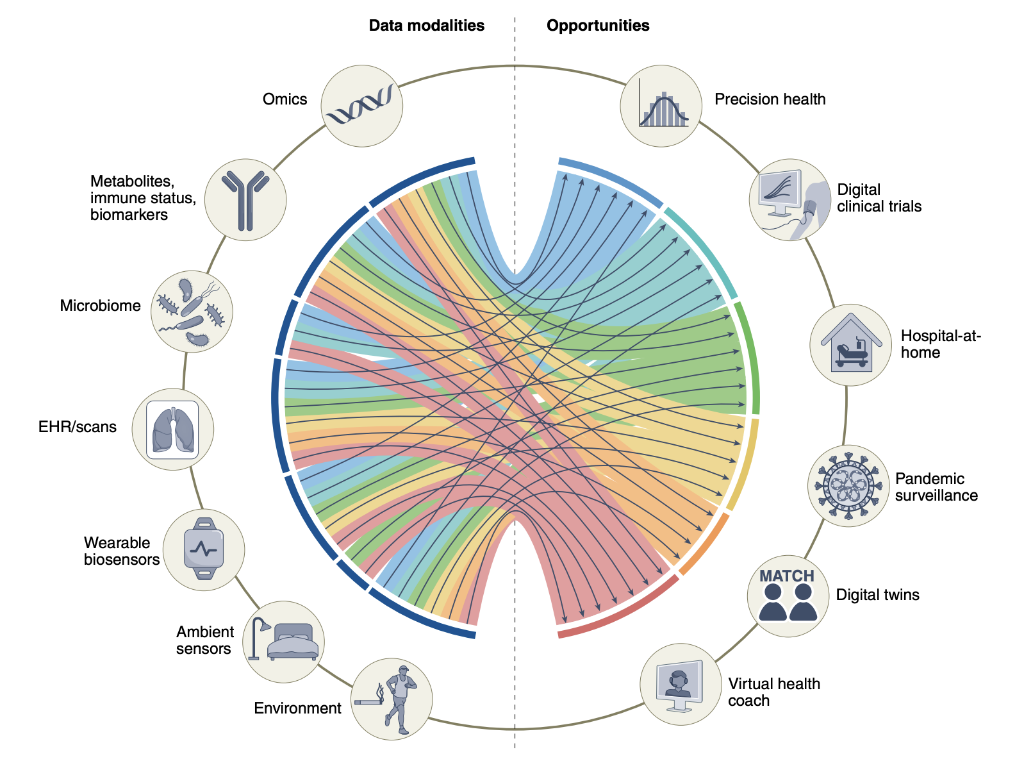
Application of Work in Healthcare & Medicine
Acosta, J.N., Falcone, G.J., Rajpurkar, P. et al. Multimodal biomedical AI. Nat Med 28, 1773–1784 (2022). https://doi.org/10.1038/s41591-022-01981-2

Slide 19
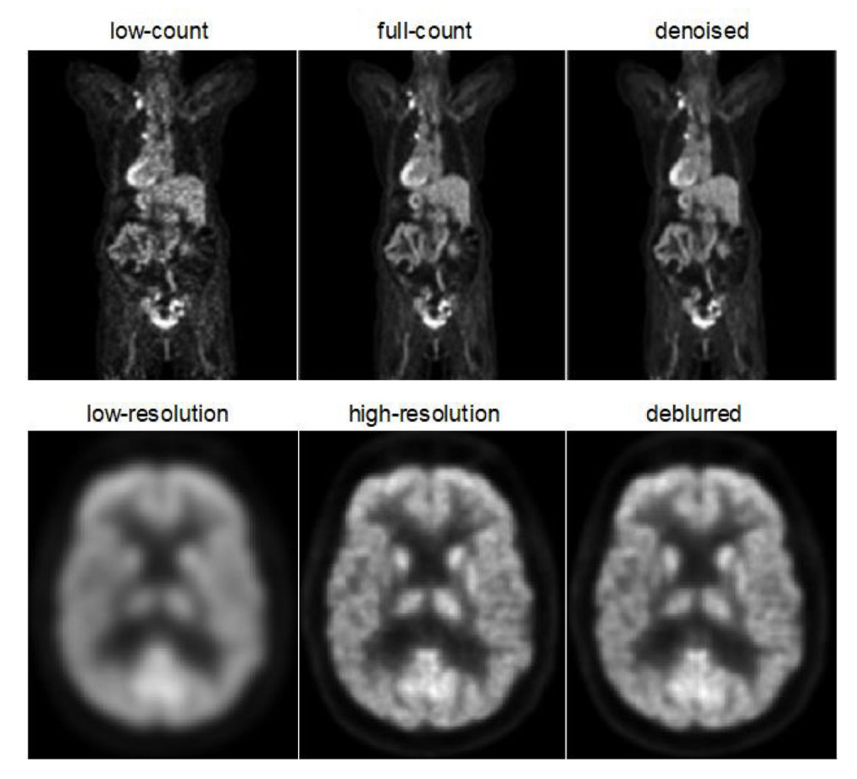
Application of Work in Healthcare & Medicine
Personalized (Individual) Medicine
Noise from images/scans
Extracting information, interpretation
Multimodal data integration
Environmental monitoring (home and ALFs)
Epidemiology (Population) Medicine
Liu J, Malekzadeh M, Mirian N, Song TA, Liu C, Dutta J. Artificial Intelligence-Based Image Enhancement in PET Imaging: Noise Reduction and Resolution Enhancement. PET Clin. 2021;16(4):553-576. doi:10.1016/j.cpet.2021.06.005

Slide 20
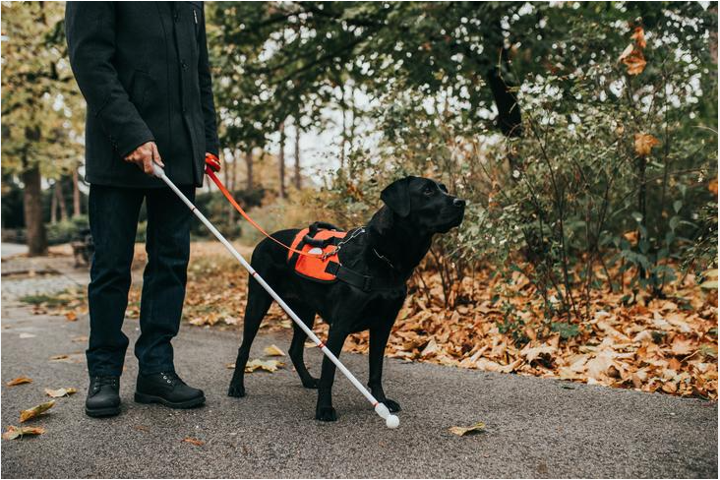
Application CONT.
Assistive Device for the Visually Impaired
CLIP model being combined with a large language model deployed to a device that can recognize & identify objects for the blind.
Advantage of the CLIP model is won’t be limited to a one-word response.
Leveraging the fact that model is trained on captions and textual descriptions.

Slide 21
Limitations
CLIP is a contrastive
PROS
Contrastive models are great at generalizing
Improves zero-shot performance
Takes relatively less time to train vs other SOTA models
CLIP is Contrastive
Scalable
CONS
Not so good at predicting
Underperforms on several specialized tasks
In early stages of research
Current hardware limits the model
CLIP is Contrastive

Slide 22
Conclusions
We enjoyed this project
CLIP is at the forefront of classification research
The model is quite complex
Introduced quite a bit of new concepts
We struggled finding the appropriate dataset
Finding the optimal training set
Not having specialized hardware
Long training times

Slide 23
The End

